Slide 1
Create your own one-page RPG
A DESIGN THINKING WORKSHOP
Nina NAVAZIO | Deepti Vaidyanathan | William ASSAF
Checklist:
Grab your worksheets from your table (“Parts 1-3” / 2 pieces of paper, front/back)
Answer at your table, "If every game existed, what would your favorite game look like?"
Notes:
<nina> Good afternoon everyone! While you’re all coming in, make sure you grab some worksheets on here or from the link, and answer in chat or in real life: If every game existed, what would your favorite game look like?
Welcome to Create your own one-page RPG, a design thinking workshop. My name is nina navazio and I’m a content designer 2 on the Windows team, and I’ve been playing RPGs since high school and even wrote essays about them in college. I’m joined by my two wonderful cohosts, Deepti and William. Deepti? … William?
Awesome, we’re ready to really get started now. Going over the checklist, please make sure that you have the worksheets you need, there should be two pieces of paper, and they should say Part 1, 2, and 3 on them. If you’re virtual, you can go to the aka link aka.ms/OnePageWorksheet to find a word document equivalent. PLEASE make sure you DUPLICATE the worksheet into your own OneDrive, so you aren’t editing the main copy of it for everyone.

Slide 2
Overview
By the end of this workshop, you will have filled out both worksheets, or have plans to fill it all out and be inspired to continue working on, creating, and playing rpgs.
PROLOGUE WHY MAKE A tabletop role-playing game
Part 1 Empathize + define: Game Foundation (+ workshop time)
Part 2 Ideate: turn actions into gameplay (+ workshop time)
Part 3 Prototype: Writing THE rules (+ workshop time)
Finale This Is all DESIGN THINKING
Epilogue Next steps for your RPG & Q&A
Notes:
<nina> So, just to set expectations, by the end of this workshop you will have filled out both worksheets you’ve got right now, or at least have plans to fill it out all, and you’ll be inspired to continue working on, creating, and playing RPGs.
I’ll also add that if you feel like writing on your worksheets at any time, like jumping ahead or you’re inspired by something and you really need to write it down, PLEASE WRITE IT DOWN! We will not be offended if we see you writing on your papers instead of listening to us. Just keep in mind that we’ll be mainly focusing on each part in order, with dedicated workshop time for each.
So we’ll start in the epilogue, where we’ll go over why you should even consider making a table-top roleplaying game in the first place. Then we’ll focus on Part 1 of the worksheet, which is empathizing and defining the game. You’ll then get about 10 minutes of workshop time to fill out that first page of the worksheet, during which all of us will be floating around, checking chat, etc. to answer questions and help you brainstorm. Next, we’ll go over ideation and how to turn your actions into gameplay. This is one of the more difficult sections of the workshop, and we’ll definitely be available for help during the workshop time. Finally, we’ll talk about prototyping and writing the rules. You’ll also get workshop time for this. At the end of the presentation, we’ll talk about how all that you’ve done today is design thinking, what a fun gotcha moment, and then we’ll go over what you can do next with your worksheets or RPG ideas.

Slide 3
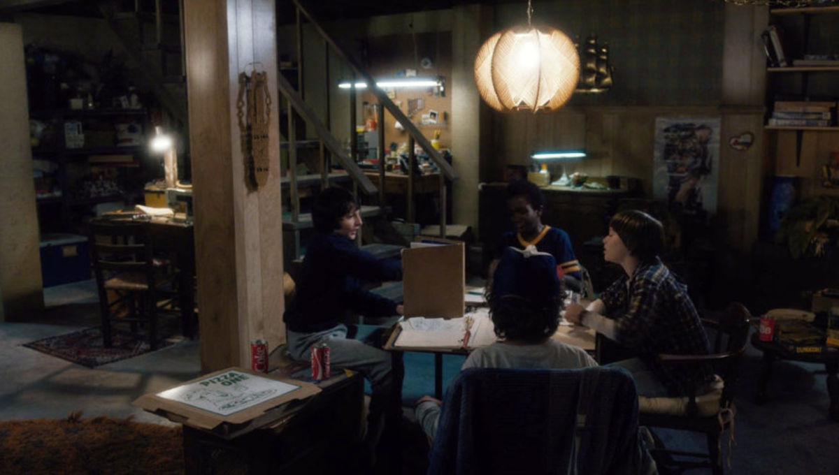
What is a tabletop role-playing game (TTRPG)?
CREATE YOUR OWN RPG
Stranger Things (season 1, episode 1)
Legal Stuff: This content and group is not affiliated with, endorsed, sponsored, or specifically approved by Wizards of the Coast LLC. Dungeons & Dragons® is a trademark[s] of Wizards of the Coast. For more information about Wizards of the Coast or any of Wizards' trademarks or other intellectual property, please visit their website at (www.wizards.com).
Notes:
<William>
So, what is a TTRPG? I think if you're in this presentation you're probably familiar with the concept of a tabletop roleplaying game like Dungeons and Dragons.
That’s the thing you saw on Stranger Things or Critical Role or Big Bang Theory or Community.
Here characters from Netflix's Stranger Things playing Dungeons and Dragons, and you can see the two roles at the table: the Players,
<click>
and the Main Storyteller
<click>
(also known as the Game Master or Dungeon Master or Main Storyteller, the terminology differs and is up to you.)
Everyone here is playing the game, but one of them knows a lot more than the others about the events as the unfold.
Now, the one-page game we’re discussing today could have a similar setup, or something different, with no difference between the players.

Slide 4
WHY MAKE A One-PAGE TTRPG?
Core mechanic + core experience or theme or vibe.
Share experiences and explore new ideas.
Raise awareness of a specific topic.
A design thinking exercise
A fun challenge
Notes:
<william>
Let's zero in on our format of a *one-page* tabletop role-playing game.
A *one-page* game focuses on a core mechanic, surrounded by a core experience or theme or vibe or mood.
We’re not creating thousands of pages of info and reference tables and spell lists and monsters of a roleplaying game system like Dungeons and Dragons. Today we’re focusing on a core mechanic and core experience for the game. In many ways, this is creatively freeing for you – you can focus on the player experience, while we exercise our Design Thinking skills.
A one-page game can focus on shared experiences and new ideas, or could be used to teach or raise awareness of a specific topic, or to explore a specific mood or vibe.
*Playing* a one-page game is closer to improvisation and open-ended creativity, it’s a looser framework with tighter core ideas. And creating one itself is an exercise in creativity, in ideation, and the empathetic people-focused process called design thinking. We’ll talk more about and explain design thinking along the way, but most effectively, we’ll be *practicing* design thinking today.
This is a fun challenge! I hope you enjoy the challenge of creating a concise set of ideas and concepts. And of course, this could be the core of a large game system, or the platform for a larger story to be told.

Slide 5
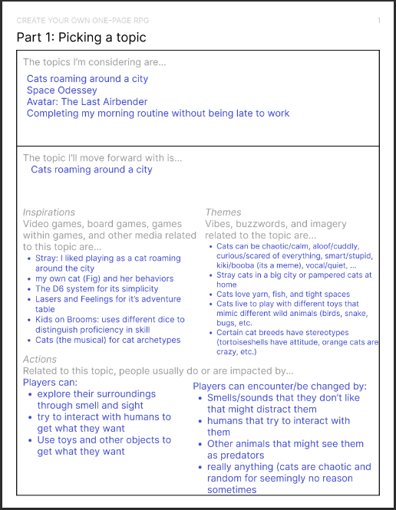
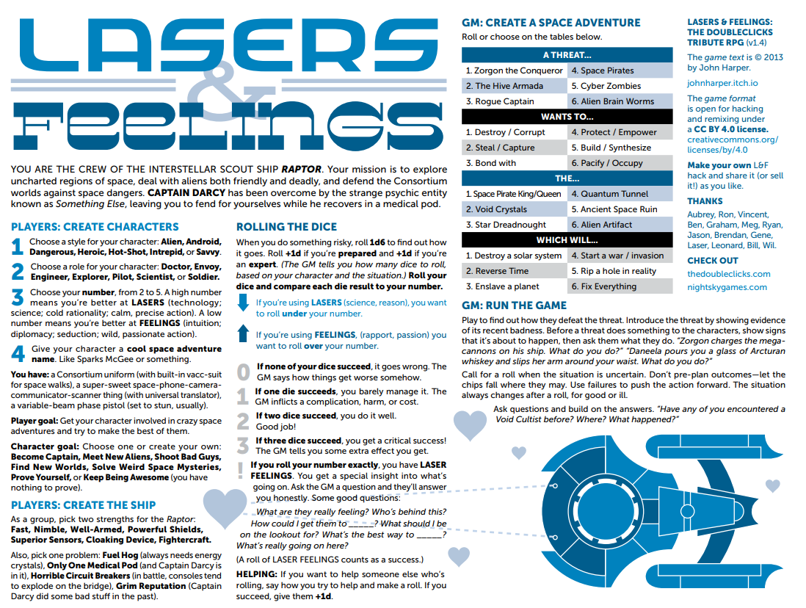
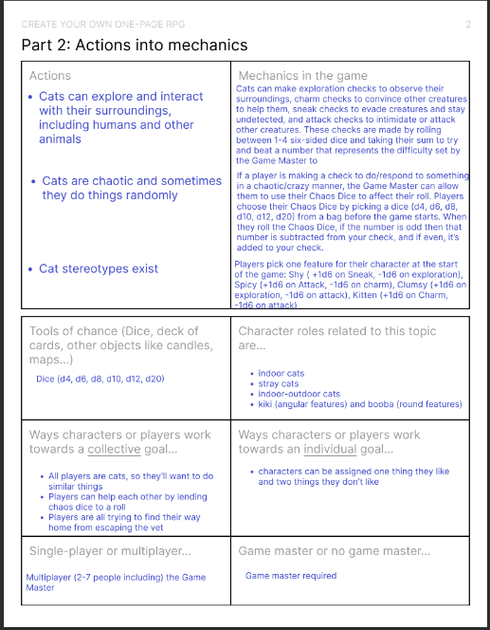
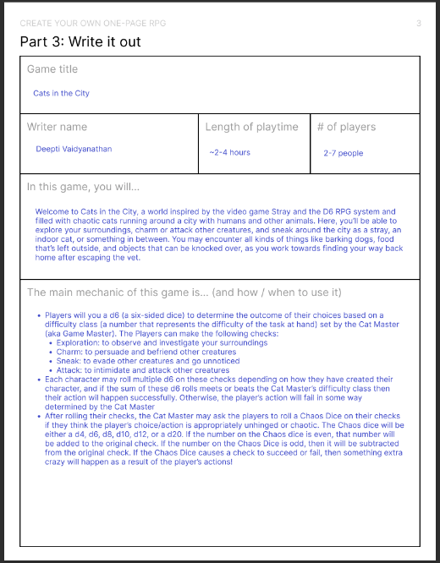
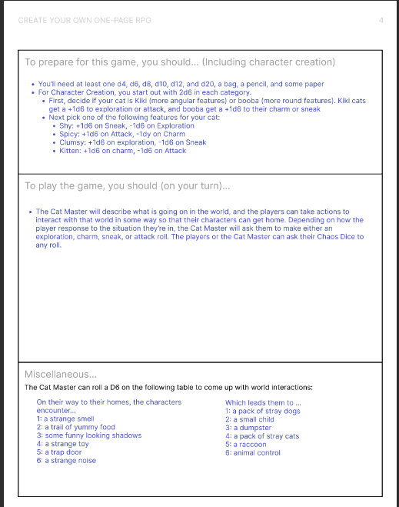
One-page TTRPG eXAMPLES
Lasers and Feelings
http://www.onesevendesign.com/laserfeelings
Our worksheets Aka.ms/OnePageWorksheet/Example
Notes:
<william>
We have a couple examples to show.
On the left is a popular and well-known one-page RPG called lasers & feelings, published by one seven design for free online. We have played this at Microsoft before, it is a tight mechanic, the concept of a <click>
a single statistic for all characters, <click>
relatively silly Star Trek or Star Wars parody ship, <click>
a loose rule about a single decision mechanic, <click>
and some fun optional scenario startup randomization. <click>
Add in a little guidance for the Game Master on how to run the game, and we even have room for a drawing of a space ship and some links.
<click>
On the right is a simple, play tested, one-page RPG created using our handouts we’re using today, called Cats in the City, we’ll be mentioning it throughout. It walks through the process we’ll cover today.
It’s not lost on us that our workshop on a one-page game features … four… pages, but the end result is something that fits on a single page.

Slide 6
Empathize + Define: Game foundations
Topic: Brainstorm and select one topic to make into an RPG
Genres, media/movies/TV shows, personal experiences, random Wikipedia articles…
What do you want the game to look like to the player(s)?
Inspirations: What are some media/games related to this topic? Is there anything they do that you could use in your game?
What tabletop games have you played and what were their rules?
Theme: How can you build "game feel" / vibes of the game?
If it's a scarier situation, what makes it scary? How do you raise the stakes?
If it's a silly game, how can players get silly?
What are some "actions" that people do related to that topic?
What do players do a lot? How does the world change the player?
Game mechanics/rules will determine the outcome of actions
Notes:
Deepti
So now that we know what we're building today, we can start making our RPGs by empathizing with our game's potential players and defining aspects of our game based on what we want our players to experience.
<CLICK> The first step is to brainstorm and research a few general topics you could turn into a game. These topics can be based on anything, you can make a game based on a genre, movies or TV shows you've seen, personal experiences like road tripping or doing your morning routine, or even a random Wikipedia article! Once you have a few ideas, pick your favorite topic that you’ll base your game on.
Now that you have a topic, <CLICK> you should think about what other external media you could use to inspire elements of your game. You can research existing references that are related to your topic, games that had engaging rules or mechanics, or even draw from your personal experience with your topic. For example, if I was making a Cat RPG, I could be inspired by my own cat’s behaviors at home, as well as video games like Stray where you roam around the city as a cat, and even unrelated games like Chutes and Ladders and Dungeons and Dragons because I like its rules.
Once you have a few inspirations <CLICK> you can use them to generate Theme words to describe the vibes of your game. How would you want a player to describe the world of your game? What sort of people or things exist in your inspirations, and could any of them exist in your game’s world? As you write down these descriptors, think about the ways you could illustrate your game’s themes to your players. If the game is supposed to be scary, how can you raise the stakes for the players? If it’s a silly game, how can players get silly? For my Cat RPG, I'd want the game to have a chaotic and silly vibe, and I could say that cats can be vocal, clumsy, spicy, etc. Or that they love yarn and tight spaces (based on my cat's own preferences for these things).
<CLICK> Once you have a sense of your game’s themes, you can start writing down common “actions” that characters could do to interact with the world or actions that could happen to them. Look back at your Inspirations and Themes and see if there’s any character-world interactions that happen frequently. What should players expect to be able to do or encounter as they play your game so that they feel the themes you wrote down earlier? These actions are going to help us make our games’ rules and mechanics because in your game, the outcome of these actions will likely be determined by the game mechanics you create. In the Cat RPG, for example, I might want my players to embrace cats’ chaotic natures, so they might expect to be able to explore small spaces, hide from scary noises, interact with other animals/humans, be generally chaotic, etc. With these actions in mind, I’d want to think about how players can determine whether their actions succeed or fail and how I can make these actions feel chaotic in gameplay (which we’ll go more into detail later).
(Slide gives instructions and tips on how to fill out Part 1 of the worksheet, and what to think about as they fill it out)
Deleted content:
What is unique about those "actions"?
How could you portray that "unique-ness" into a game, like a "game mechanic"?
How can those "actions" be illustrated in gameplay, to help players really experience what it’s like to do those things?
These actions are going to serve as the basis for our game’s mechanics which will help us determine the outcome of , so as you’re writing them down start thinking about ways that they can be illustrated in gameplay
fleshing out what our game should look like from the players' perspective.

Slide 7
WORKSHOP: EMPATHIZE & DEFINE
PART 1
10 MINUTES
FIELD | DESCRIPTION | EXAMPLES
Topic | What your game will be about | Genres, movies/TV shows, video games, personal experiences, … (Cats)
Inspirations | Media that’s related to your topic and games + their mechanics that you’ve liked | For “Cats,” video game Stray, my cat Fig, Dungeons and Dragons, Chutes and Ladders, …
Themes | Descriptors for what your players would see/feel in your world | For “Cats,” chaotic, silly, lots of cats, maybe other animals, running around a city, …
Actions | Ways your players can interact with the world and vice versa | For “Cats,” players could explore small spaces, knock things over, … Players could also encounter scary dogs that chase them, animal control, other humans that try to pet them, etc.
Feel free to move on to other sections as you brainstorm
Nothing needs to be perfect!
Notes:
Deepti
So now we’re going to take about 10 minutes to fill out Part 1 of the worksheet, where you’ll be doing some topic generation and light research so that once you pick your RPG topic you can fill out your Inspirations, Themes, and Actions. A few notes before you get started:
<CLICK> This is a brainstorming phase so don’t edit yourself just yet!
Put every idea on the page even if you’re not sure if you’ll use it, and feel free to update other sections in this part as you think of new things.
Most importantly, we’re only building a first draft today so <CLICK> NOTHING HAS TO BE PERFECT! Focus on getting something workable on the page, if you need help or have any question we’ll be walking around in-person and monitoring the chat for virtual participants!
This workshop time will be about 10 minutes to fill out Part 1 of the worksheet,
the goal of this section is to brainstorm without filter so that they have plenty of ideas to choose from in the next sections
We'll also provide an example worksheet that we've filled out to give them a sense of what it might look like

Slide 8
Ideate: TURN ACTIONS INTO GAMEPLAY
The core of an RPG, or any game, is its “mechanics”
According to Wikipedia: Rules and parts of a game “that govern and guide the player's actions, as well as the game's response to them.”
E.G. In the game of Life, the main “mechanic” is going through life events.
What backgrounds can players have to make them feel special?
Customization is key (within reason)
Focus on attributes players can pick that help build a backstory
Consider single or multi-player, with a Dungeon Master (DM) or DM-less
Notes:
<nina>
You’ve picked your topic, brainstormed some actions and activities that someone might do related to that topic, and now we’re going to turn those actions into gameplay. The core of an RPG, or any game really, is it’s “mechanics”. The “Mechanics” of a game are the rules and parts of a game that govern and guide the player’s actions, and also how the game responds to those actions.
Take the board game Life for example. The main mechanic in that game is literally “going through life” and experiencing major life events like going through school, getting married, and getting a job. The way these are determined are partially by player choice ( like which routes you take on the board), and partially random (by spinning a spinner to determine where you land next). This simulates real life, because we can pick the route in life we go down, but we never have control over everything that happens to us.
<click>
When designing mechanics, also consider what backgrounds can players have to make them feel special? These usually take the form of customization, or some kind of backstory that the players build before the game starts, or during gameplay. Like in the Game of Life, you start the game by deciding to “Start a career” or “go to college“. This decision will impact your gameplay later, as some cards that you can draw during the game change depending on whether or not you have a college degree.
For your game, you can focus on mechanics that let your players build a backstory. This is usually done by giving players attributes that are relevant to your topic when building their characters, and then using those attributes to decide game outcomes. As another example, consider the Cats in the City game Deepti made. Players play as cats, and before the game starts, they get to make their own cats. During the character creation process, players pick whether their cats are fat and fluffy, or if they’re slender and slick. Then players get to decide if their cats are clumsy, sneaky, charismatic, and several other choices that can result in tons of different cat combinations. By letting players pick the aspects of their cats, they can make a cat that they really want to play, and that is entirely different from the other players in the game. At the same time, this simulates the fact that every cat is unique as well.
You’ll also need to consider if this game is single or multi-player. This can also relate to your topic– in the game “The Quiet Year”, players collaborate together to tell the story of a village as it grows and prepares for an oncoming doom. There is no dungeon master or controller in this game, and operates similar to how you and your friends might tell a story together to someone else– everyone adding in their own piece of the story. Since there is no one person controlling the entire narrative, people may disagree– which is also a natural part of storytelling– and there’s a mechanic for that. You can hold a “grudge” against someone for a part of the story they told that you don’t agree with, and that “grudge” has future consequences in the game. In this way, even the decision about whether or not your game has a dungeon master can be a mechanic. Perhaps your game has a “rotating dungeon master” mechanic where every so often the dungeon master changes; or maybe part of the game is to figure out who the dungeon master is! Or maybe there’s no dungeon master at all, and players are able to set up the game themselves and decide the outcome of events on their own. Whatever you decide, it should be informed by your topic, or be complimentary to the mechanics you create.

Slide 9
ACTIONS → MECHANICS
Standard mechanics in RPGs:
Customize a character with a stat
During the game, decide to do something
Dungeon master asks you roll a die and you have to get higher than a specific number they set in order to succeed
You roll the dice and add your stat (which you customized at the beginning)
The outcome is illustrated by the dungeon master
Turning actions into mechanics
What action is being done?
Is there any randomness involved? Cards, dice…
How do you determine the outcome?
Pick just one, maybe two mechanics
One page is not a lot of space!
Notes:
<nina>
During the following workshop time, you’ll get to think about how to turn your own actions into mechanics that should be closely tied to your topic. All the examples I’ve listed seem to work naturally together– but how might you get to that point?
Let’s first consider one of the most standard mechanics in a roleplaying game: the stat, or attribute number. This could be a skill number, characteristic… in Dungeons and Dragons, all players have the same 6 attributes: Strength, dexterity, constitution, wisdom, intelligence, and charisma. These are the basic building blocks of a character in dungeons and dragons, and all their other stats and abilities tend to stem from these attributes. When you make a character, you get to assign numbers to those attributes. Some players roll dice and randomly assign them, others get to pick from a pool of numbers– it all depends on your Dungeon master’s house rules on how you want to assign numbers to them– but regardless, you end up with an array of attributes, each with a number that says something like “+2” or “-1”. These attributes also feed into your backstory—if your characters a bard and plays music and sings for a living, perhaps their charisma is their highest stat. On the other hand, if your character intensely studies magic, perhaps intelligence or wisdom is their highest stat. In this way, every single character you create in dungeons and dragons is unique.
During gameplay, these stats are used to determine outcomes of game events– for example, if you’re trying to persuade a king’s guard to let you into the castle’s gold vault when you definitely should not be allowed in there, the dungeon master may ask you to roll a “Charisma” roll to see if you successfully persuade the guard. The dungeon master will give you a number to beat, usually somewhere around 10 – 25, and you’ll roll a 20-sided dice, and add your attribute. So if the dungeon master said it was a 15 difficulty to persuade the guard, and you only rolled a 14 but you have a +3 to charisma– that means you rolled a 17 and you did it!
In this way, dungeons and dragons lets players customize their characters—to simulate you really living in the world of dungeons and dragons, and building your own story– and then the deciding mechanic for actions in the game relies on those decisions you made earlier.
So during the workshop, the first question you could ask yourself is: What action is being done? For example, when Deepti created Cats in the City, she considered what actions cats in cities take. One of those actions is that sometimes cats can get a little crazy and random, so she wanted to simulate that feeling in the game. You may have already done this during your brainstorming. If so, great! If not, no worries, you will definitely have time to work on it in a moment.
Once you have an idea of an action to take during the game, you could ask yourself, is there randomness involved? In the Cats in the City example, yes. The whole thing she is trying to simulate is randomness and chaos, so Deepti decided to alter the usual “roll a die and check a number”. Similar to Dungeons and Dragons, each cat in the game has personality traits represented by numbers, like sneakiness or charm. If you decide to do something in the game, the dungeon master will ask you to roll a die to see if you succeed. But to simulate that chaotic feeling of cats, the dungeon master may ask you to roll a “Chaos die”, which will either add or subtract from your initial roll– meaning it could make or break your success. Because players don’t know when the chaos die is coming, this is a good representation of the chaos of cats, and how they can be rewarded (or really hindered) for doing something crazy.
Your game can similarly twist on the “roll a dice and check a number”, or it could twist on it entirely. How might you use a deck of cards to add randomness to your game? The game 10 candles relies on 10 literal, actual candles sitting in the center of the table, and depending on how many are lit, things happen in the game. So that means that gameplay can change when you have to put out a candle, or if one gets put out accidentally.
And the last question you could ask yourself is, how do you determine the outcome? In many of the examples I’ve mentioned, it’s a player rolling a die and checking it against a static number, usually assigned by the dungeon master. But what if they had to beat a die roll from the dungeon master? Or draw something on paper? Or actually persuade other players to let them do something? Or pay some kind of “currency”? In the one-page RPG “Everybody’s John”, players control just one character in the world: john. All the players are the voices in his head, but only one can make major decisions at any given time. In order to gain control of John’s attention, players must “bid” their “willpower” by literally taking an amount of tokens in their hand and revealing them at the same time. Whoever bid the highest gets control of John, and can make decisions for a set amount of time. In this way, the decision about who controls John’s attention isn’t random, but rather dependent on what other players do.
Finally, just keep in mind that you should pick just one mechanic. Maybe two, if you have two that are really super cool. But remember that all these rules and instructions on how to set up characters and how to play the game should be able to fit on one page– this is a one page RPG after all– and you’ll get to see if everything fits on one page later in this workshop. But for the time being, try to stick to one or two mechanics that compliment each other and the topic really well, and think them all the way through. Remember that mechanics can have several aspects, like creating characters that have attributes that then impact the story, so they can get complicated quickly!

Slide 10
WORKSHOP: IDEATE
PART 2
15 MINUTES
Examples of ideas turned into mechanics:
Create one or two of your own for your game
GAME | ACTION / IDEA | MECHANIC
Road Trippin’ | You’re on a road trip and you have to hold in pee, and get increasingly desperate for a bathroom | A “pee meter” that goes up periodically, which makes other rolls worse
Astronomers | You discover planets no one has ever seen before and see what their attributes are | Pulling a card from a standard deck of cards and comparing it to a table; e.g. all “7s” are considered “extremely hot” planets, all “clubs” are really large; etc.
10 Candles | Telling a scary story at night, that is still slightly hopeful, but always in the brink of disaster | Literal, actual candles on the table determine some outcomes of the game, and regardless of how they’re blown out, that’s part of the game to
Cats in the City | Cats are chaotic and sometimes do crazy things that hurt them, but also help them | The dungeon master can ask for a “chaos roll” at any time that could help or hurt cat, and the cat does not know when it’s going to happen

Slide 11
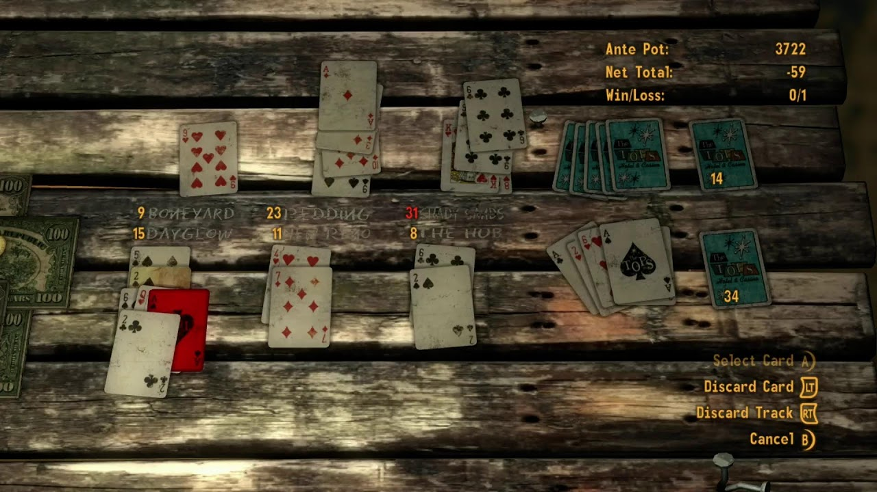
WRITING THE RULES
"If I had more time, I would’ve written less."
Aim for information-rich, easy to explain
Can you easily explain your core mechanic?
How could the mechanics add immersion?
Screenshot from Fallout: New Vegas, Xbox
Notes:
William
Remember, we're recreating a one-page roleplaying game. Though much of the guidance in today's workshop would help you design something larger today we're talking about a one-page ruleset for, potentially, a narrow set of scenarios or settings or purposes. You're not creating a Generic Universal RolePlaying System, you're creating your finely tailored, perhaps bespoke, role-playing game.
For a one-page RPG, start simple. After today, to continue developing your idea, you’ll use play testing to simplify and unify the rules, sift out extraneous details, and to tighten your pitch. Only include rules for what is necessary and important.
So, I'm an author and technical writer for Microsoft, and in my field there's a great quote about brevity. "If I had more time, I would have written less." There’s a lot of versions of this idea, it's been associated with various quotable folks throughout history, the evidence probably points to 18th century French mathematician and philosopher, Blaise Pascal. Think of a time like Pascal's when wordsmithing and crafting a message involved relatively expensive inks and paper and candlelight and quills made of feathers or reeds. A time before cheap writing instruments. We're not just talking about time but the resources it took to craft, iterate, and edit down a message. The wisdom here is that with careful time and attention, we *can* communicate better, with fewer words.
These days, we are unbound by resources like ink and paper and feathers. If we're in a hurry, we'll find ourselves writing in loops, writing disorganized tangents, or writing less about the core of our topic. So if today you end up with a two or three-page RPG, or even a board game, that's ok, maybe after some playtesting and wordsmithing, you'll end up with a sleek, information-rich, easy to explain, one-page RPG.
<click>
In further pursuing a tight, efficient ruleset, you should craft a quick pitch you can tell people, to give them an idea of what the game is about. Is this a tidy little game about being crew members on a ship, like in Lasers & Feelings? Or a micro RPG about being an astronomer, or on a road trip, or being cats in the big city? What’s your core idea?
Some tips here. Let the players interpret what they want to, what's most fun, or perhaps doesn't really need to be bound by rules. Are two mechanics similar? Combine them. Is a rule more clever than immersive? Maybe cut it. And of course, your rules should embrace the rule of cool! In any storytelling game, the Game Master should have an attitude that we should try to make cool stuff happen, even if it bends the rules.
<click>
Similarly, can you explain the game's mechanics in just a few sentences? Even big RPG systems have their core mechanics simplified.
In D&D, roll a d20, higher the better. There’s a number to beat. That’s it.
I can explain the core mechanic of the Free League Year Zero system to you right now - roll a bunch of six-sided dice and count the 6s. If you roll just one 6, and you succeed. Done. That's it. No math. Brilliant system. Each game in the Year Zero system, which are big systems with big books, has little twists and modifications, but the basic mechanic is that. A pile of d6s, count the sixes. (And sometimes the 1s.)
We're not trying to explain a euro style board game here. For example, I've got a hundred bucks that you can't explain how to set up and play Settlers of Catan: Cities & Knights, with all its counters and stacks, to a group of friends in less than 15 minutes. Keep the rules concise.
<click>
How can the game's mechanic contribute to immersion in the game?
How many of you played Caravan, the card game inside of Fallout: New Vegas? One of the core mechanics of the game is that you are using cards from a standard 52-card playing deck, but only those cards you've found scattered around the wasteland. That mechanic is so clever, integrating the junky chaos of the wasteland into the game itself.
There is a roleplaying game named Dread, a horror setting where tangible anxiety is built by the core decision mechanic, a physical game of Jenga. As the Jenga tower gets more precarious, tension rises at the table and in the game. If the Jenga tower falls, bad stuff happens. In Dread, your game’s physical presence on the table, or the items used to play it, or the communication requirements or limitations, could all contribute to the immersion.
For another example, in the immersive roleplaying game Alice is Missing, all the players must solve the mystery of a missing teenager by communicating only via texting. Typed text only. The game is silent. Talk about immersion!

Slide 12
WRITING THE MECHANICS
CREATE YOUR OWN RPG
Limit the number of mechanics.
Aim for a single mechanic that is easy to teach.
Do not mix logical operators/comparisons.
Use one method of comparison: under/over, counting, summing, etc.
Necessary content only.
Content can be fun to write. But is it necessary?
Notes:
William
In dungeons and dragons 5e there are rules and different formulas for broad jumping vs long jumping, with or without a running start. Your one page RPG should not have rules for broad jumping vs long jumping, with or without a running start. :) Limit the number of mechanics in your one-page RPG. Consider a few mechanics, and try to wrap your system around two, or maybe just one. Say what you wanted about D&D 4th edition, I will entertain your D&D4e slander, but most character classes played exactly the same. Everyone had a standard move minor, every round of combat, every class had the same way to track the scarcity of abilities. It was **easy to teach**. Take that one virtue of D&D4e as an example.
<click>
If you have multiple mechanics, and that's ok if you do, avoid mixing different types of comparisons or logical operators. For example, if your game includes players assigning a number to a stat and then rolling over that number, that should be the only way to roll a die and check it against a number in the game. Do not include another mechanic where you have to roll under, or do additional math, counting vs summing, etc. Try to settle on just one probability scheme, so that players can at least easily know what a good die roll looks like. It doesn’t have to be higher or lower. It doesn’t even have to be dice. But it should at least be concise.
<click>
Consider the content you want to write, that you enjoy to write, vs the content needed to play a game. I playtested an RPG that contained a dozen pages of starship components and modules, under the fairly unusual possibility the characters are in a position to buy an expensive starship. The author really wanted to explore what starships could look like and create lots of options. I get it. Space ships are rad. Massive tables of inventory, loot, and stats for them, are fun to build, but not necessary to run a one-page RPG game!
Ok, with all that said, let’s get to writing the rules and mechanics of your game in our next workshop period!

Slide 13
WORKSHOP: PROTOTYPE
PART 3 (BOTH SIDES)
15 MINUTES
Describe your game and its main mechanic
Define how the game starts, what happens on a player's turn, the game’s loop, etc.
Tips:
Use your work in Part 1 and 2 to fill out these sections
Consider adding quick ways to make an adventure, like providing example adventures or tables to randomly generate a story
Nothing has to be perfect!
Notes:
Here where you get to dive into the mechanic, the game’s loop, etc.

Slide 14
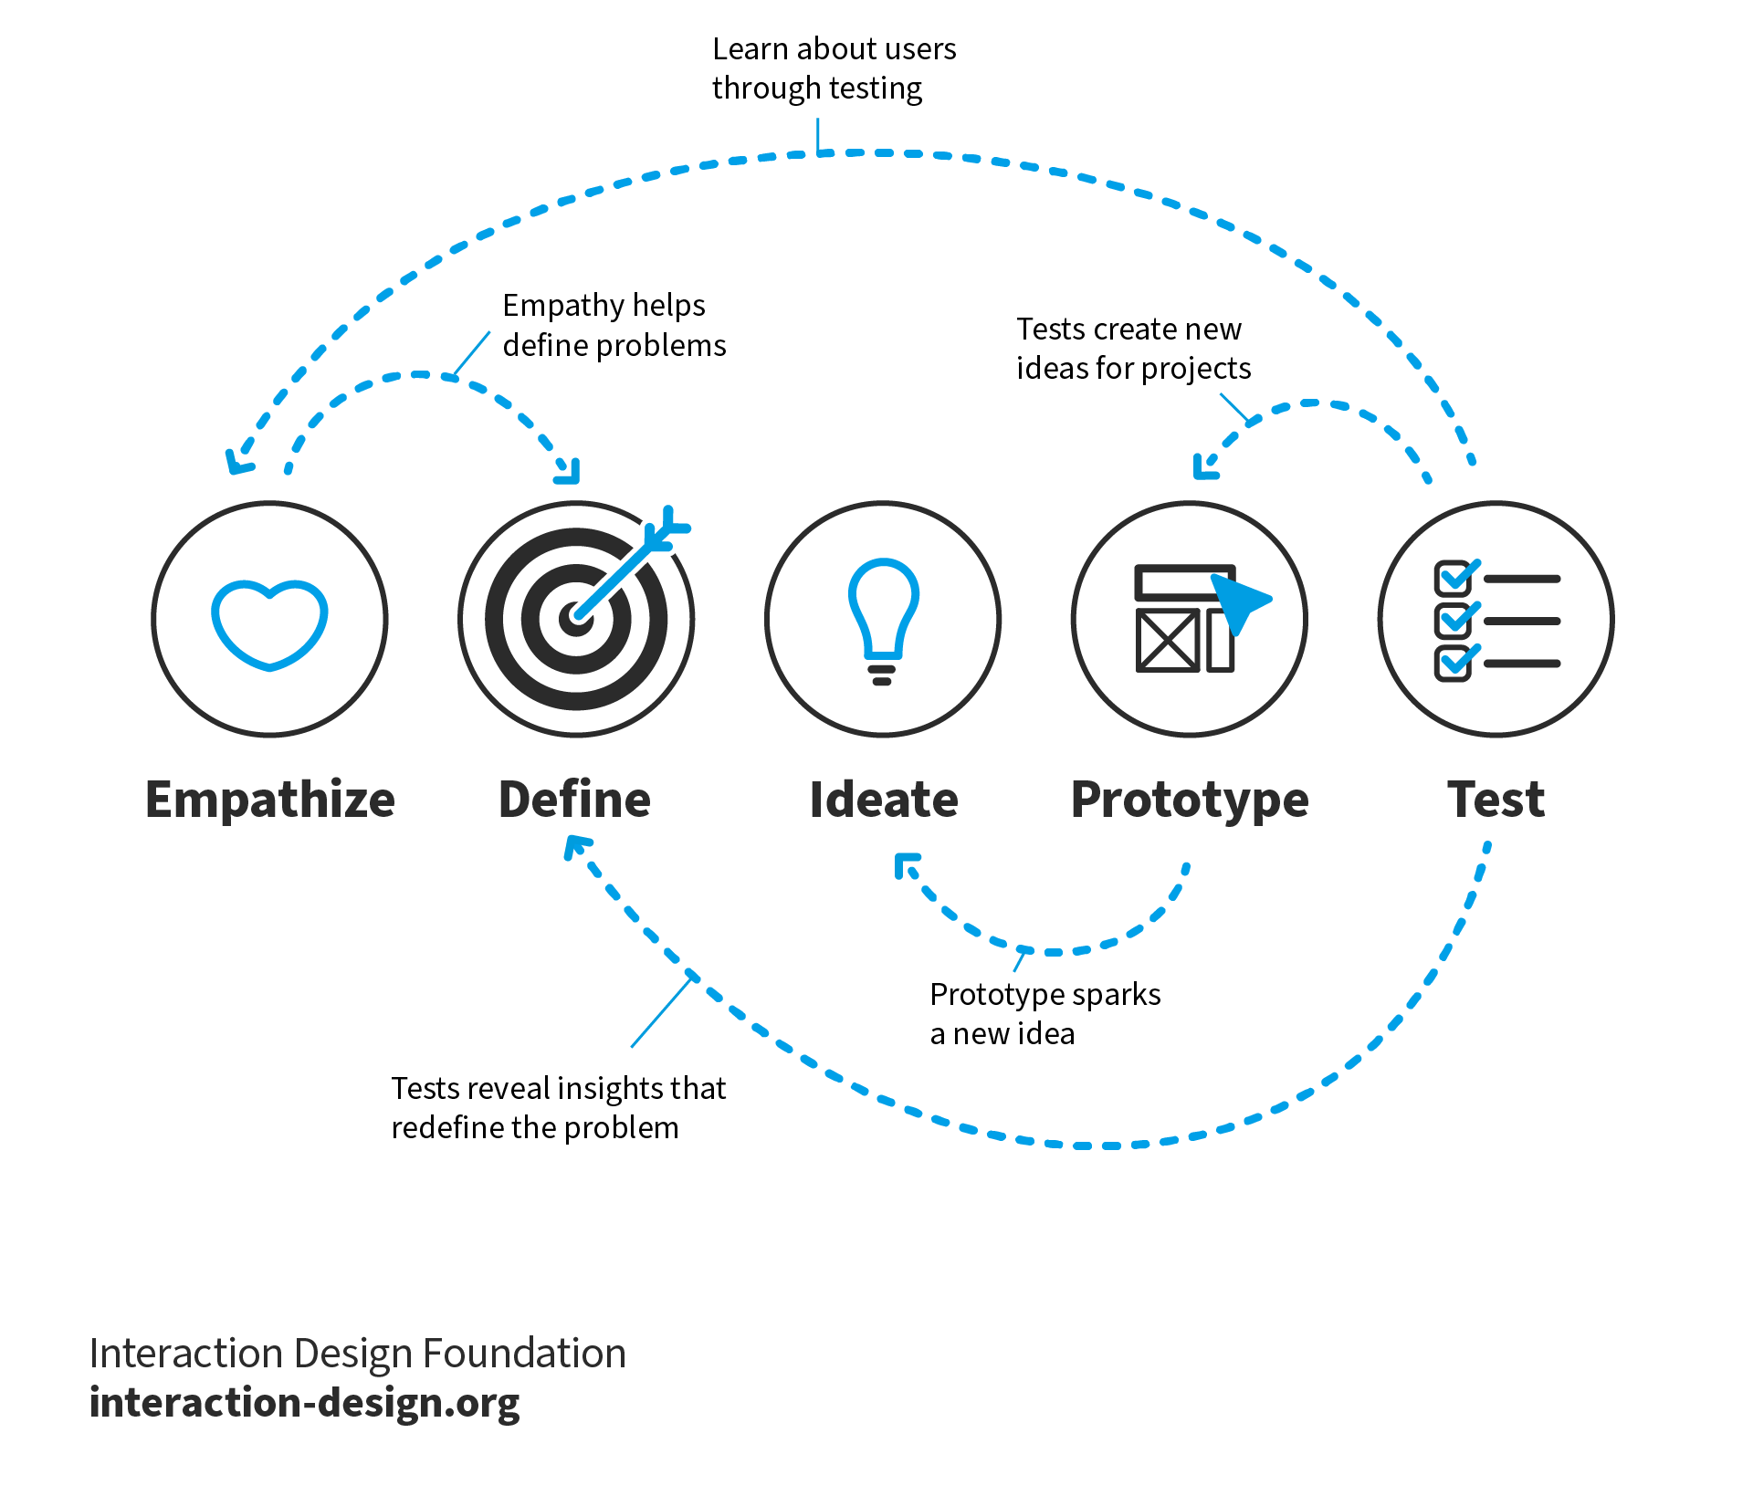
Design thinking
“Design Thinking is a discipline that used the designer’s sensibility and methods to match people’s needs to what is technologically possible and a viable business strategy to convert into customer value and market opportunity.” – Tim Brown
Design thinking is a way to create anything, work on any project, in a way that is human-centered at its core and favors progress over perfection
Notes:
Deepti
It might not have felt like it as you were making the game, but everyone here just used Design Thinking to make an RPG!
<CLICK> Design thinking was originally adapted for business purposes by the design consultancy IDEO and its founder Tim Brown. <CLICK>They used it as a way to understand business needs and challenges and find solutions to problems in a way that’s human-centered at its core and favors progress over perfection. ​The trick in design thinking is to get into the shoes of the customer, to understand what they want and empathize with them in every step of the design process.
<CLICK> It allows us to build robust solutions by having us iterate through multiple stages of <CLICK> empathizing with our audience, <CLICK>defining our problem space, <CLICK>generating ideas for solutions, <CLICK>prototyping the best ideas, <CLICK> and testing these prototypes to gather feedback that we can integrate into our next iteration. Frequently development in one stage can lead to updates in any or all stages regardless of order, <CLICK> and the design thinking framework encourages us to bounce between these stages regardless of order so that we can maintain creative freedom while keeping our ideas organized.
We tie all the work we've done to abstract design thinking principles.
Emphasize that Design Thinking is an iterative process, we've only helped them with the first iteration of their game but they can repeat these steps to improve their game
This is why we emphasized that nothing needs to be perfect, Design Thinking favors progress over perfection

Slide 15
Design thinking
What you did:
Empathize – you thought about a topic, and considered your game mechanics from the player’s POV
Define and Ideate – you thought about the fun in the game and defined the rules.
Prototype – you wrote a playable draft of your game's rules
What's next:
Test – you can test your prototype by having someone else play your game and give feedback on what worked and what didn't
Iterate – you can repeat this process to integrate feedback into new drafts of your game
The 5 Stages in the Design Thinking Process | IxDF (interaction-design.org)
Notes:
Deepti
When you think about what we did while creating the game, <CLICK> we started out by picking a topic and empathizing with our “audience” (aka the players of our game) so that we could describe what they should be able to do and/or experience while playing the game.
<CLICK> Once we had a sense of what we wanted our game to look like, we defined game mechanics that would help our players experience the events that occur in our game and how we could build the “fun” in the game.
<CLICK> Finally, we wrote a prototype (or playable draft) of the game’s rules!
<CLICK> We’ve only produced the first draft of your game in the workshop, so the next steps for your game would be to <CLICK> test it by having someone else play your game and give feedback, and then <CLICK> repeating this process to integrate that feedback into future drafts of your game! I’ll also note that especially for one-page RPGs, iteration doesn’t always mean adding more rules or making things more complicated. For every iteration you should remind yourself of what the ultimate goal of your game should be, and depending on that it might make more sense to broaden definitions or provide less content so that your players can fill in the gaps themselves. Nina tell us more about next steps for your game
We tie all the work we've done to abstract design thinking principles.
Emphasize that Design Thinking is an iterative process, we've only helped them with the first iteration of their game but they can repeat these steps to improve their game
This is why we emphasized that nothing needs to be perfect, Design Thinking favors progress over perfection

Slide 16
What to do with your game
Playtesting
Ideally, observe other people playing your game (without you playing with them or participating). Take silent notes, and don’t talk while they’re playing.
Let people interpret the rules how they want to. You can adjust your wording, but role-playing games are generally up to interpretation.
Encourage them to think out loud: if they are confused about something, or want to try bending the rules, ask them to explain their ideas.
Publishing
DMs Guild, DrivethruRPG, Roll20
Itch.io
GitHub, your own personal website
Notes:
<nina>
And now that you’ve all got in your hands a worksheet with some amazing ideas on it for an RPG, what might you do next?
The first thing you should consider it playtesting <click>. Once you've got a version of the game you're happy with, gather a group of friends (or even some people at work or at conferences) to playtest your game. You should observe other people playing your game, without you playing with them or participating. Take silent notes, and don't talk to the players while they're playing. And this is mainly so you can see how people will interpret the rule. You can adjust your wording afterwards so it's closer to what you want people to read, but roleplaying games are generally up to interpretation. Some people may even come up with amazing ideas you didn't think about! And my last tip for playtesting is to encourage people to think out loud. If someone seems confused about something, or wants to try and bend the rules, ask them to explain their ideas. But remember: they can ask you questions all they want, just don't answer! They can instead propose the question to the group they're playing with, or if it's a single-player game, they can try to resolve the question on their own. If they're really truly stuck, and can't see a way to play the game without the question being answered, then you can break the fourth wall and talk to them. Hopefully you two can work out what's confusing, what you as the writer meant, and how it can be improved. After you've playtested your game, you could consider publishing it in some way. Websites like the DMs Guild, Drivethru RPG, and Roll20 are open marketplaces where you could put up your game for others to find and play. Similarly, Itch.io is a website that is commonly known as an indie video game platform, but it also hosts a significant amount of RPGs. There was actually the onepage RPG jam recently! So you could even join communities on itch that make similar games to what we made today. And finally, you can always host on Github as a Github Pages, or on your own personal website.
Regarldess of how you publish, players should know where to go t ofind the downloadable and printable versions of your games, as well as how to get updates about any new versions or changes, and where to find other games you make.

Slide 17
Thanks | Q&A | show & tell
Download slides here: https://aka.ms/ttrpgsatwork
RPGs mentioned in the talk… | Why it was mentioned…
Dungeons and Dragons | Most common table-top roleplaying game people know played in Stranger Things and Big Bang Theory
Lasers & Feelings | Well designed one-page RPG
Cats in the City | RPG created by Deepti using this workshop’s format; includes “chaos” mechanic
Ten Candles | “Candle” mechanic where real, lit candles impact gameplay
The Quiet Year | No Game Master, and players can make decisions that cause “grudges”
Everybody’s John | Bidding mechanic to “gain control” of the story
Road Trippin’ | “Pee meter” that impacts game play (designed by nina)
Astronomers | Drawing cards to simulate discovering planets (designed by nina)
Alice is Missing | Completely silent; No game master; players must text each other
Dread | Horror style game where a game of Jenga is used for tension
Caravan | Junk-based card game inside Fallout: New Vegas where you can only play cards you find
Gwent | Collectable card game inside Witcher games where you can only get cards from boss fights
Notes:
<nina>
And that's all we've got for you! If you have a moment, please leave a comment in the chat or come up and tell us after the session about any feedback you have. We especially want to know if: - The worksheets were big enough / well formatted. Was anything confusing, or not enough space? - AND if the workshop time was enough time. Should we cut any slides in order to give you more workshop time??
And we’ll leave you with a list of all the games we talked about during this talk, and if anyone has any questions we're more than happy to answer them. If anyone would also like to share the game they made and get some feedback, definitely feel free to raise your hand and we can discuss. We hope that you’re inspired to continue working on this game, play it with your friends, and continue design thinking throughout your day. Thanks!

Slide 18
Let’s playtest! (quickly)
PLAYTESTING
30 MINUTES
We’ll spend the next 30 minutes playtesting each other’s games.
Talk with the other people at your table, and pick one of your games to play for 30 minutes OR agree to read through each other’s papers one at a time and discuss the ideas (about 5 minutes per game for a 6-person table).
Give feedback to the other people at your table:
What do you like about their topic?
Do the mechanics of their game match the topic?
Is there any mechanic or aspect of a mechanic missing?
Does the game make you feel the same way you’d feel about the topic / doing the activity? If not, is that ok or on purpose?
If they have a draft of the character sheet or rules, do you have any advice or suggestions?

